Slide 1
4.4.1 FTP Intro and Microsoft FTP
SMB but across different networks and OS

Slide 2
What is FTP?
File Transfer Protocol → client service protocol to transfer files between computers on the internet
Relies on communication channels between client and server
Command channel for controlling conversation
Data channel for transmitting file content
Security weaknesses: brute force attacks, FTP bounce, packet capture, port stealing, spoofing and username enumeration
With FTP, users can establish port connections with remote machine and perform any necessary data transfers
Executing an FTP port connection = two stage process
Authorization of FTP client and connection to server made by client

Slide 3
More On FTP
Network functionality that allows users to upload files from personal computers to server where websites are located (also vice versa)
Is provided through a TCP network protocol
Default command port for FTP connections = port 21

Slide 4
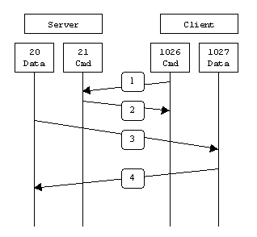
Active v Passive FTP
Active Mode
Connects from unprivileged port (N>1023) to FTP server’s port (21)
Client listens to port N+1, sends to server, server connects to that specified port (from 20)
Incoming connections on port N+1 needs to be opened on the client!!
Active FTP:
command: client (>1023) -> server (21)
data: (client >1023) <- server (20)

Slide 5
Active v Passive FTP
Passive FTP (PASV)
Designed to resolve problems with firewalls and routers (that didn’t allow active connection)
When opening FTP connection, client opens two random unprivileged ports (N>1023 and N+1)
Server opens its customized unprivileged port (P>1023) and sends to client in response to PASV command
Incoming customized port needs to be opened on server!!
Passive FTP:
command: client (>1023) -> server (21)
data: client (>1024) -> server (>1023)

Slide 6
FTP Commands
Some Notable Commands (caps don’t matter)
Cd → changes directory
Bye or Disconnect → exits from FTP
Delete → deletes a file
Dir OR Ls → lists files of the remotely connected computer
Get → get a file
Put → send a file
Pwd → prints working directory
Remotehelp → get help from remote server
Type → sets file transfer type

Slide 7
FTP Command-Line Options for Win
ftp [parameters]
-v suppresses verbose display of remote server responses
-n suppresses auto-login upon initial connection
-i turns off interactive prompting during multiple file transfers
-d enables debugging
-g disables filename globbing
-s:filename specifies text file w ftp commands that automatically run
-a use any local interface when binding data connection
-w:windowsize overrides default transfer buffer
Computer specifies computer name or IP address of remote computer to connect to

Slide 8
Try the command-line out!
Open cmd
type in “ftp speedtest.tele2.net”
specify “anonymous” for user and put anything you want for the password
once login is successful, run “dir” or “ls” to list the FTP directory
exit ftp

Slide 9
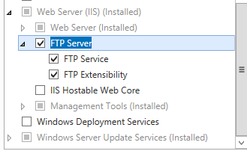
How To Set Up FTP Role
Server Manager > Add roles and features > Expand Web Server (IIS) role > Check FTP Server

Slide 10
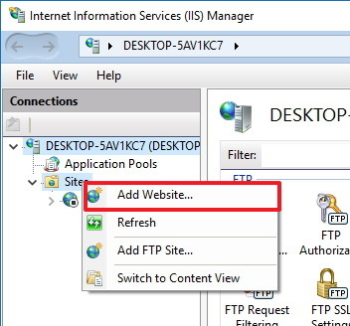
How To Create FTP Site?
Right click on Sites and Select Add FTP Site…
Specify the site name and physical path of the share, then select the IP address and type port you want it to run under

Slide 11
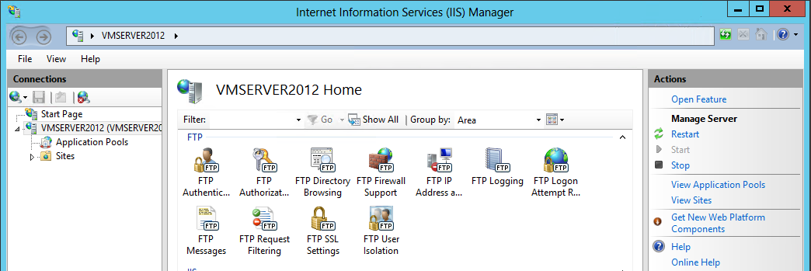
Manage settings here. You have authentication, directory browsing, logging, messages (like Message of the Day banners), SSL settings, and more

